Slide 1
Tsinghua University Economic History and Development in Latin America Instructor: Prof. Lucas Llach (affiliation: Universidad Torcuato Di Tella, Argentina) Lecture 2/8. European Conquest and the Integration of LatAm to the World Economy

Slide 2
Dynamics in the Economic History of LatAm: Shocks From Outside
Conquest (c. 1500)
Demographic collapse
A New Economic Hierachy
The Internationalization of the LatAm economy within the Iberian (Portuguese & Spanish) Empires
Independence (c. 1820)
Opening to international trade
National economic policies and the beginnings of macroeconomic instability (inflation, financial crises, defaults).

Slide 3
Dynamics in the Economic History of LatAm: Some Shocks From Outside
The effects of the Industrial Revolution
Demand, supply & specialization
The Transport Revolution, winners and super winners.
Deglobalisation (1914-1960s), Reglobalization (1970s and especially since 1990s) and the Ascent of the East.

Slide 4
Dynamics in the Economic History of LatAm: Inside Forces
Pro-global vs anti-global inside forces: the Stolper-Samuelson hypothesis and its relation to politics.
The costs of institutional weakness and instability.
Is inequality inefficent? The "extractive institution" hypothesis.
Distributional conflict in democratic and stagnant societies.

Slide 5
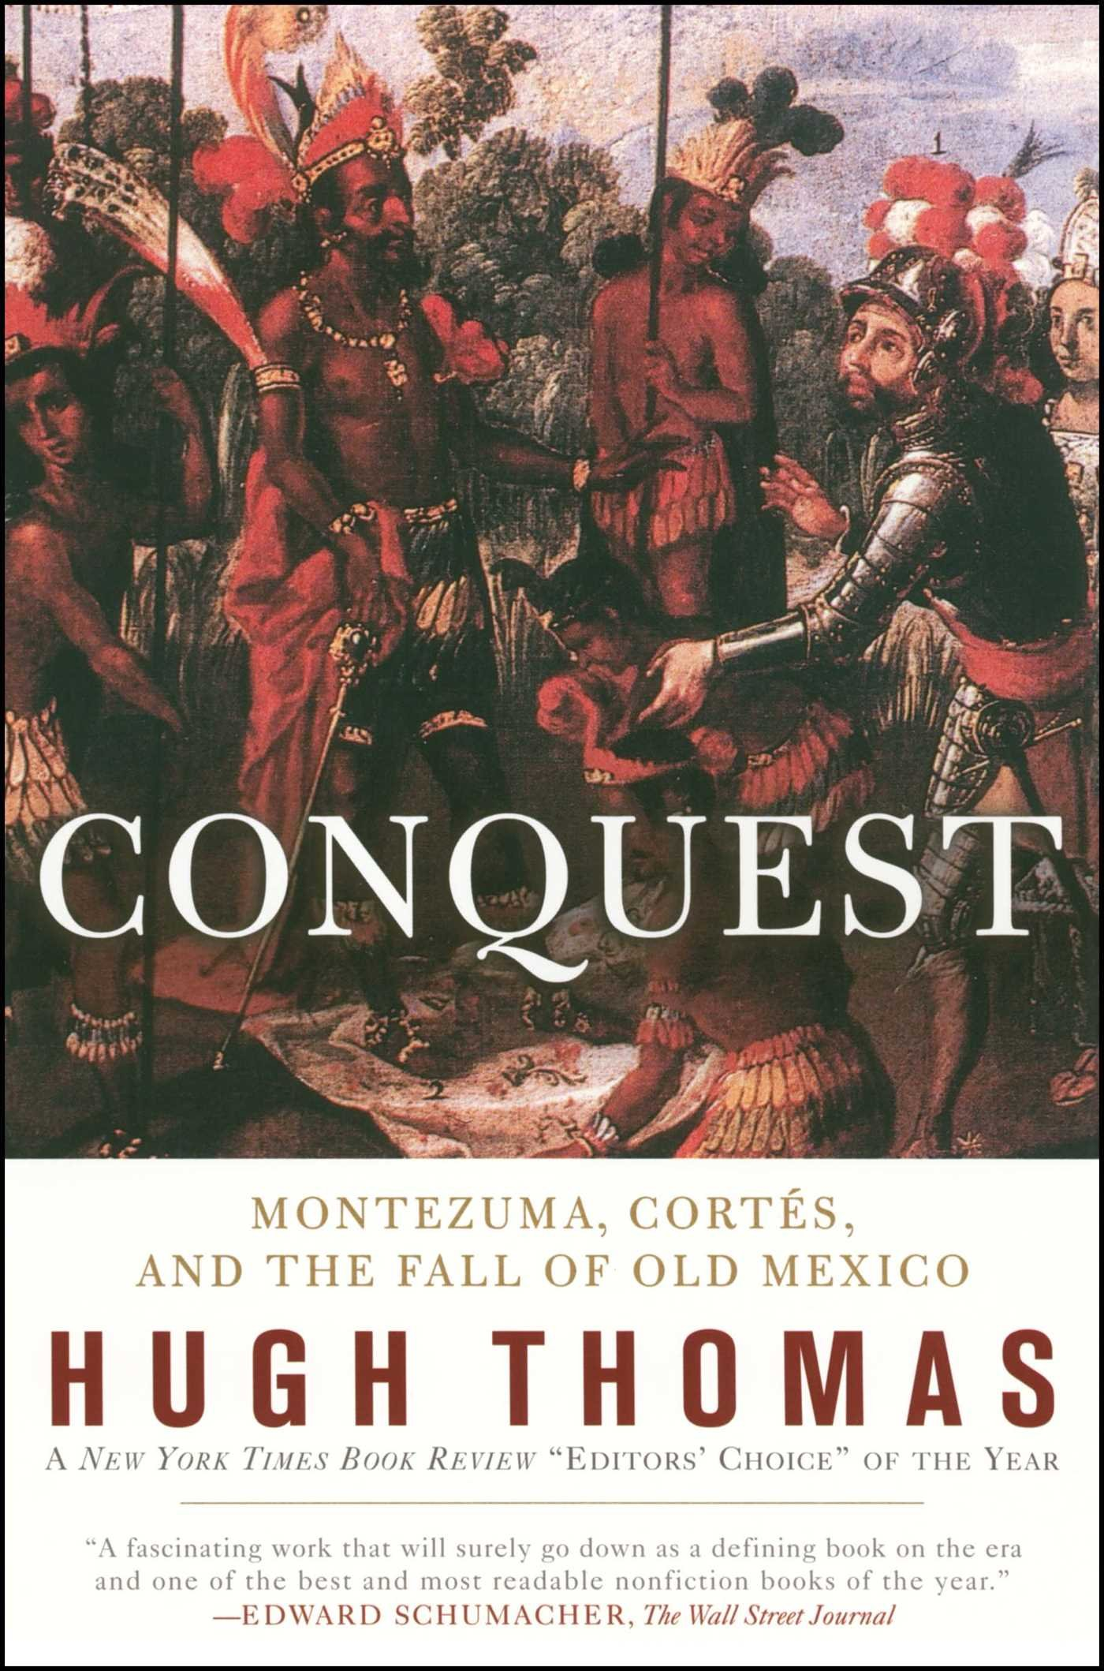

Slide 6
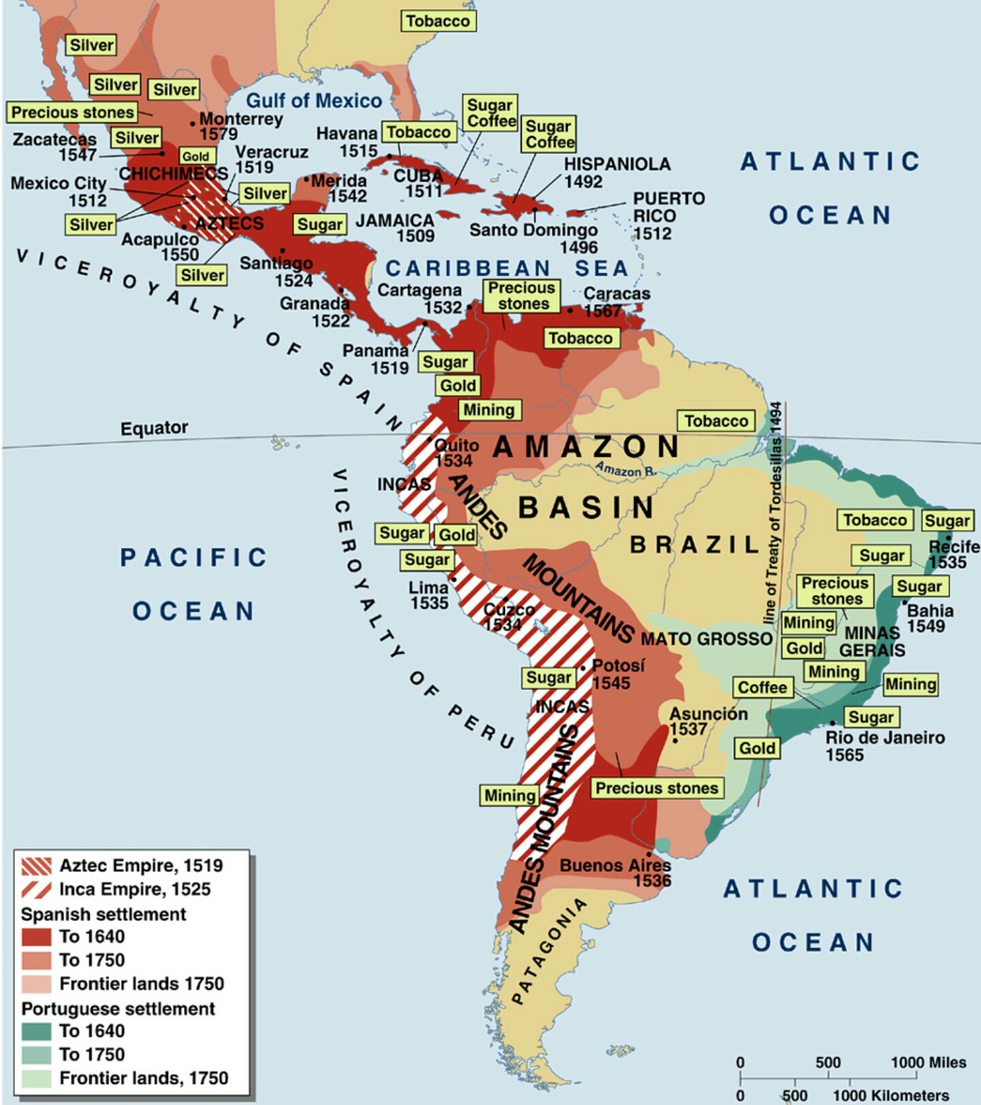

Slide 7
Some aspects of the PreColumbian economies and societies
Dominating regions: "Mesoamerica" (particularly modern-day Mexico) and the Andes (around present-day Peru): Aztecs and Incas. Other sedentary chiefdoms and civilizations.
Resources:
Developed agriculture.
No use of metals for machinery or weaponry.
Poor transport: no horse, no wheels except in toys (in the Ancient World existing since 3000BC/5000BC) so limited trade.
What "modes of productions"? Self sufficiency + tribute in kind ("taxes") or labor ("centralized feudalism").
More State-centered in the case of the Inca.

Slide 8
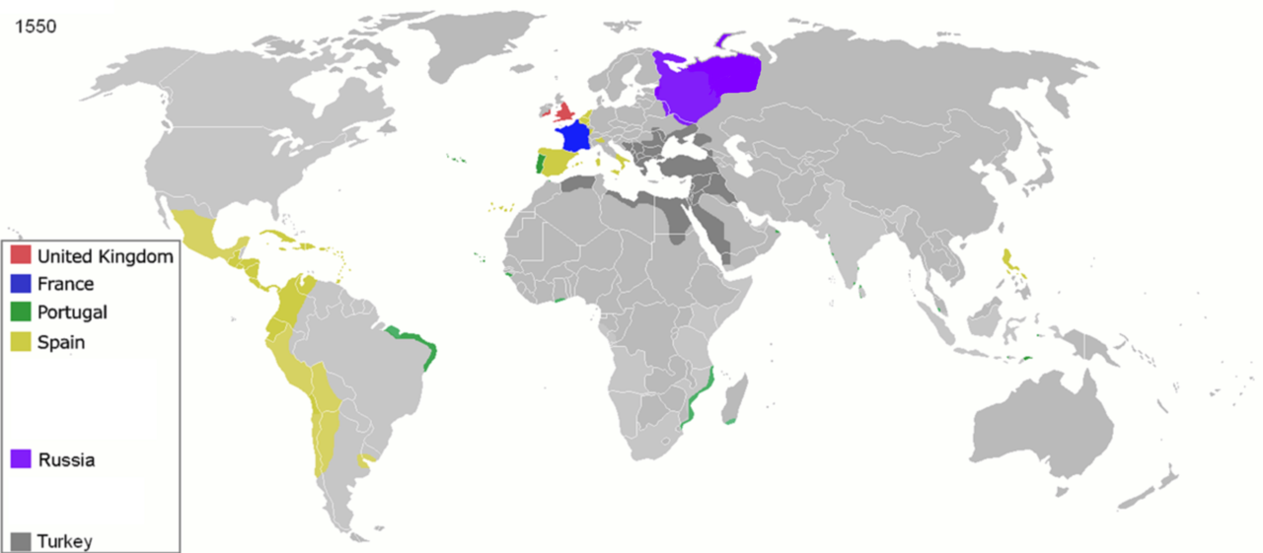
Why Europe? Why Iberia?
1550

Slide 9
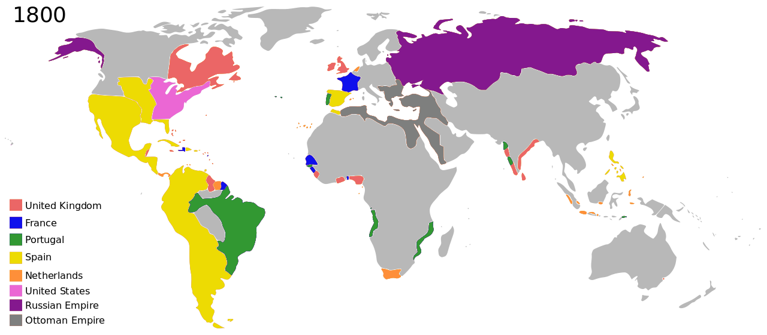
Why Europe? Why Iberia?
1800

Slide 10
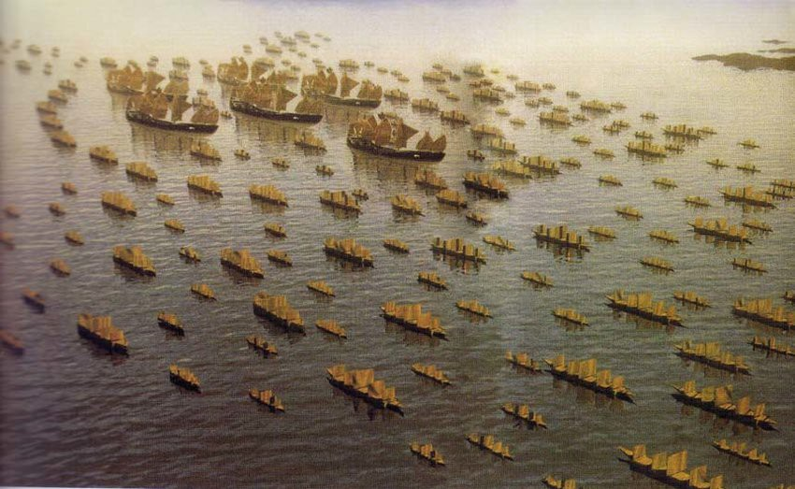
Why Europe? Why not Zheng He?

Slide 11
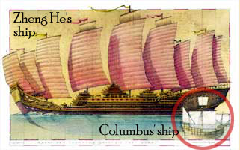
Why Europe? Why not Zheng He?

Slide 12
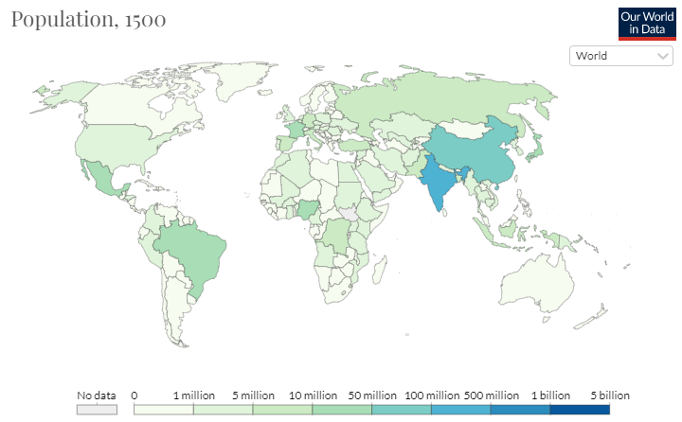
Why Europe? Why Iberia?

Slide 13
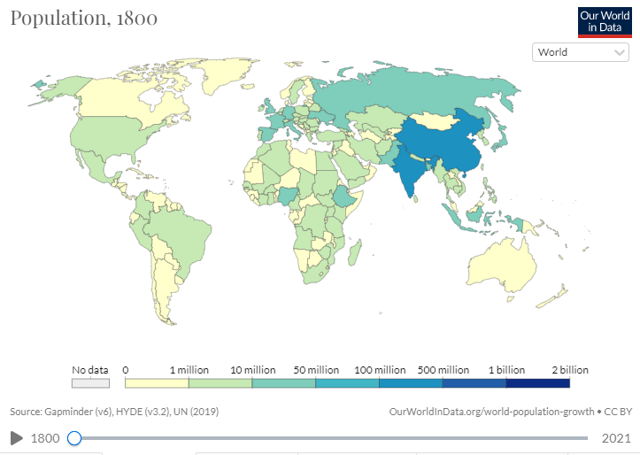
Why Europe? Why Iberia?

Slide 14
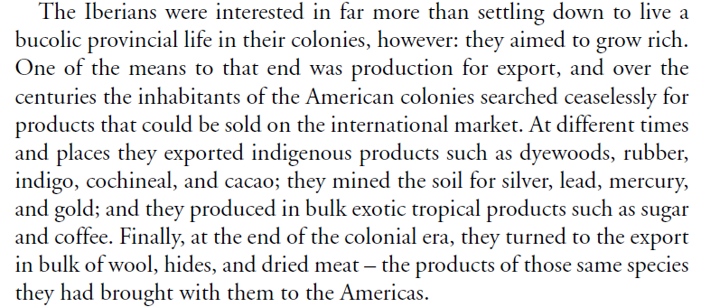
Why colonize?
Source: Elinor Melville, in the Cambridge Economic History of Lat Am chapter 4. In Google Drive.

Slide 15
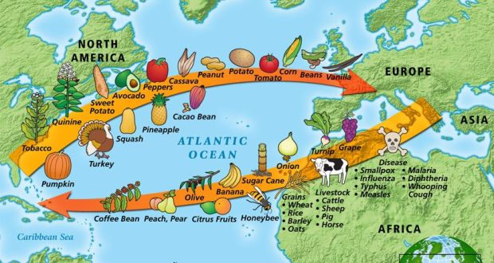
The Columbian Exchange…

Slide 16
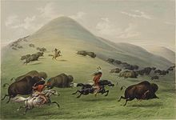
With many consequences…
Diseases
Livestock haciendas/estancias
A new cereal agriculture, still not exportable (transport costs)
Horses and its effect on production, transport and ecology
Incoporation of "plantation commodities" eg., sugar
Forced migrations

Slide 17
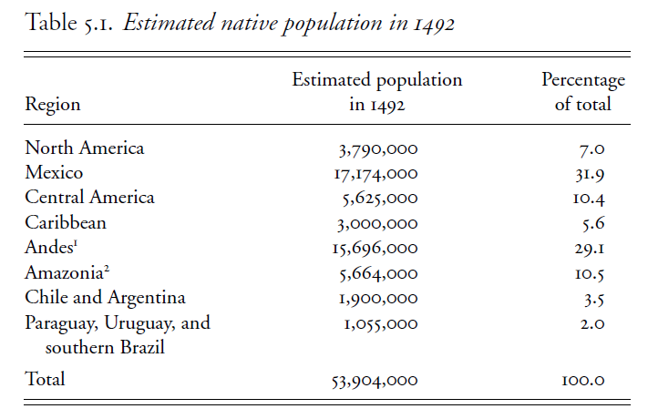
The Demographic Collpase: A "Black Legend"?
Source: Linda Newson, The Demographic Impact of Colonization

Slide 18
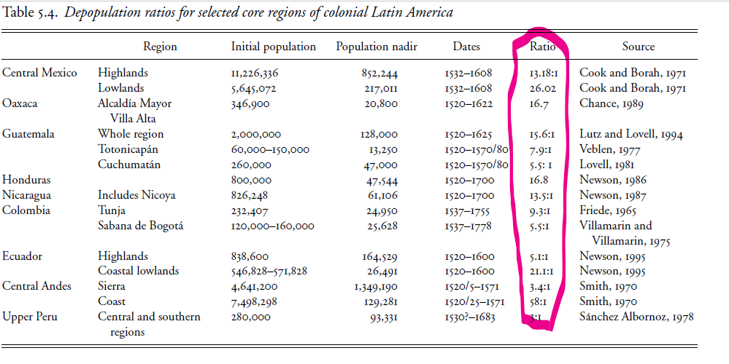
The Demographic Collpase: A "Black Legend"?
Source: Linda Newson, The Demographic Impact of Colonization

Slide 19
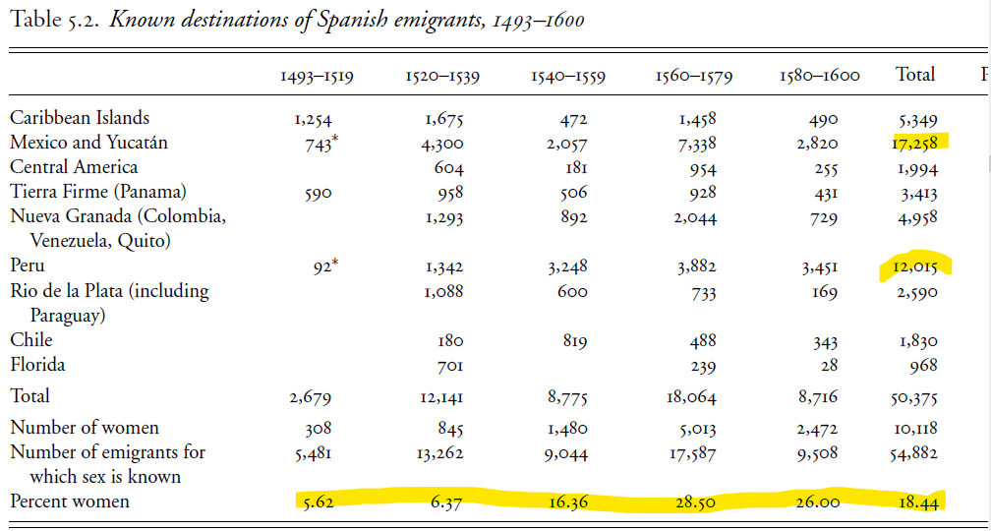
People attracted people…
Source: Linda Newson, The Demographic Impact of Colonization

Slide 20
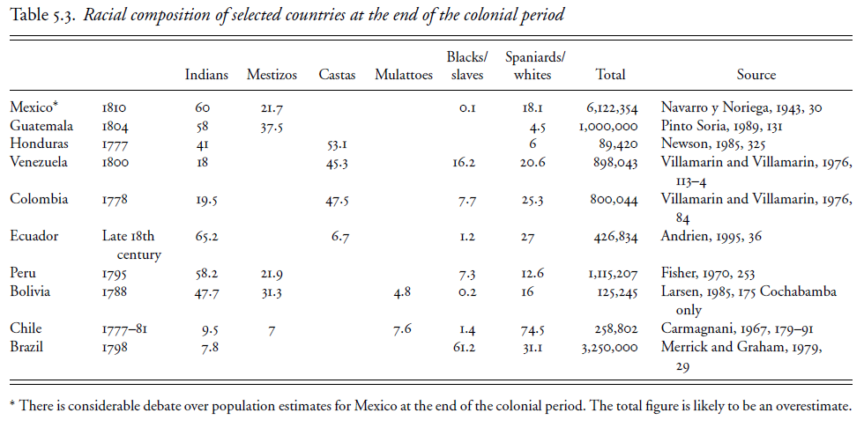
…and they would mix
Source: Linda Newson, The Demographic Impact of Colonization

Slide 21
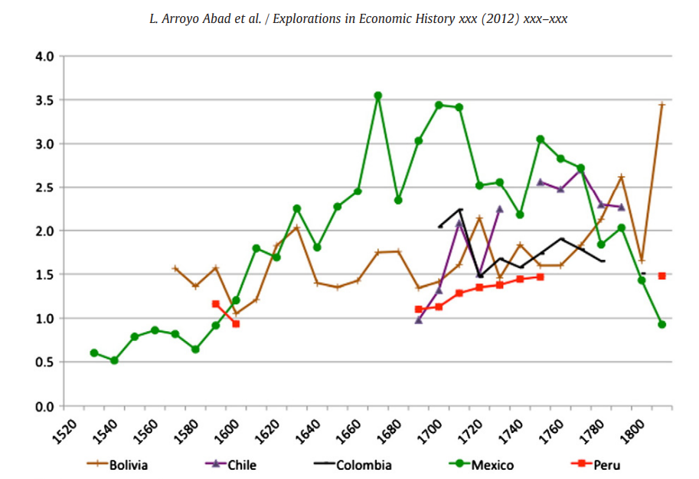
The Demographic Collpase: A Malthusian Effect?

Slide 22
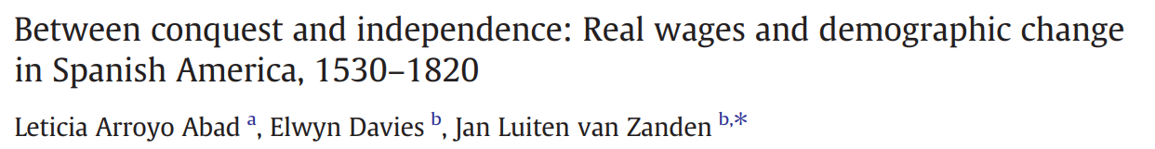
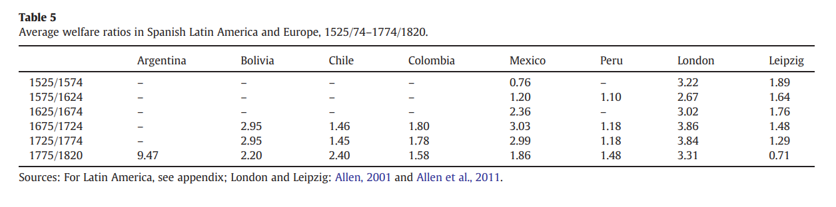
The Demographic Collpase: A Malhusian Effect?
Source

Slide 23
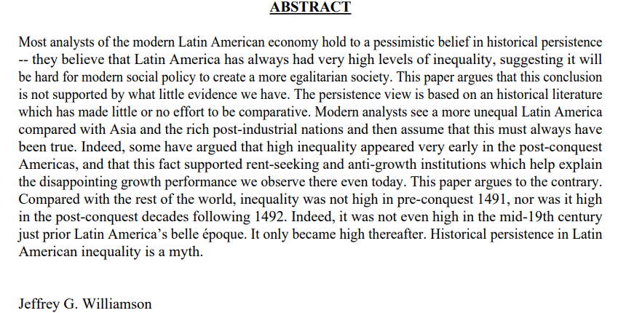
Was Colonial LatAm unequal?
The "inequality possibility frontier" and LatAm economic history (paper by Williamson)

Slide 24
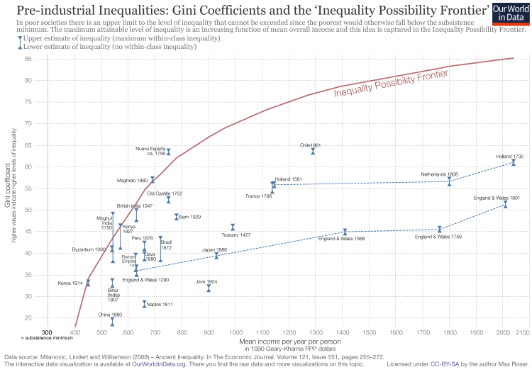
Was Colonial LatAm unequal?
The "inequality possibility frontier"

Slide 25
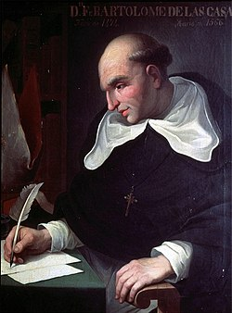
Labour systems and exploitation
From Indian slavery & encomienda (a very "privatized" system)...
…to repartimiento/mita...
to African Slavery...
..to wage labor + debt peonage
Many combinations that made distinctions less clear-cut: ore-sharing in mines, slave plots in plantations, "slaves for rent"
Bartolomé de las Casas

Slide 26
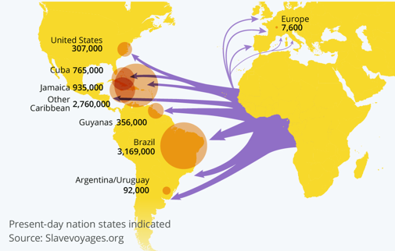
The "Peculiar Institution" & The Middle Passage

Slide 27
The Economic Structure of Colonial LatAm A Typology
Mining economies (parts of Mexico & Peru, present-day Bolivia, Brazil in the 1700s).
Plantation economies: the Caribbean, Brazil, parts of Colombia.
Population economies (parts of Mexico & Peru)
"Empty spaces" eventually agricultural: Argentina, Uruguay, parts of Chile.

Slide 28
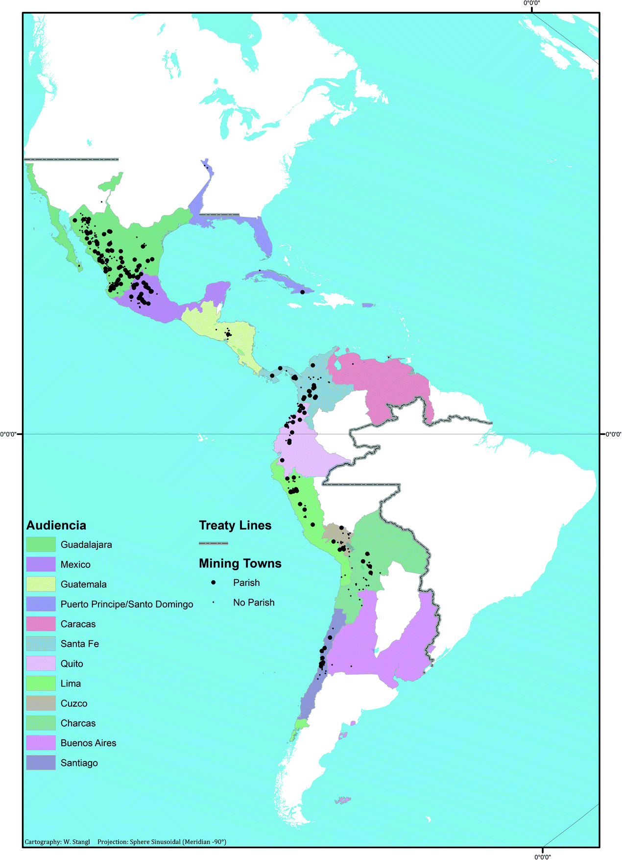
A lot of Eldorados
Source: Warner Stengl. A Matter of Scales: Understanding Spatial Patterns of Colonial Spanish America’s Silver Mining in the Digital Age

Slide 29
The "contribution of the periphery" debate
Spain: Y ansí el no haber oro ni plata, en España, es por averlo, y el no ser rica es por serlo. ("And thus there's no gold or silver in Spain beacuase there is so much; and Spain is not rich for it being so rich").
Other potential channels of "contribution":
Profits from trade in general (Marx) and the slave trade in particular (Eric Williams) financed the industrial revolution.
Demand for manufactures (but intra-European trade still dominates).
"Specie" for payments to Eastern Europe and Asia.
Supply of critical inputs for the industrial revoluton (eg, cotton)

Slide 30
Political economy
A faraway Crown, relying on Imperialism by Contract: private finance of expeditions, grants of monopolies, tax farming.
Three centuries of relative stability (compare to Europe). Why?
Costly land empires, not really interesting for foreign powers
Diversity & distance. Conflicts tended to be local
"Checks and balances" between royal officials and colonial elites

Slide 31
Economic Performance: Static gains, long-term stagnation
Static gains:
"Frontier effect" of new technologies
"Terms of trade"-driven wealth
Dynamic drags:
Land tenure systems
Castas system: República de Indios v República de Españoles and its effect on labor markets
Intrincate and discriminatory judicial system.
Why "inefficient institutions"?

Slide 32
Insitutional Theories Engerman/Sokoloff and "factor endowments"
Factor endowments (resources/labor)
Income distribution
Institutions & policies
Economic performance

Slide 33
Insitutional Theories Acemoglu/Robinson and settler mortality
Settler mortality
Large stock or European settlers
"European"/inclusive institutions
Economic performance
A "Reversal of Development"?

